Slide 2
The firm
Michael Damianos & Co LLC is a Cypriot boutique law firm with a strong corporate, banking, energy and private client focus.
The firm has a highly international practice and an expanding client base, ranging from high-net-worth individuals through to a variety of corporate entities and multinational organizations (private/public companies and funds).

Slide 3
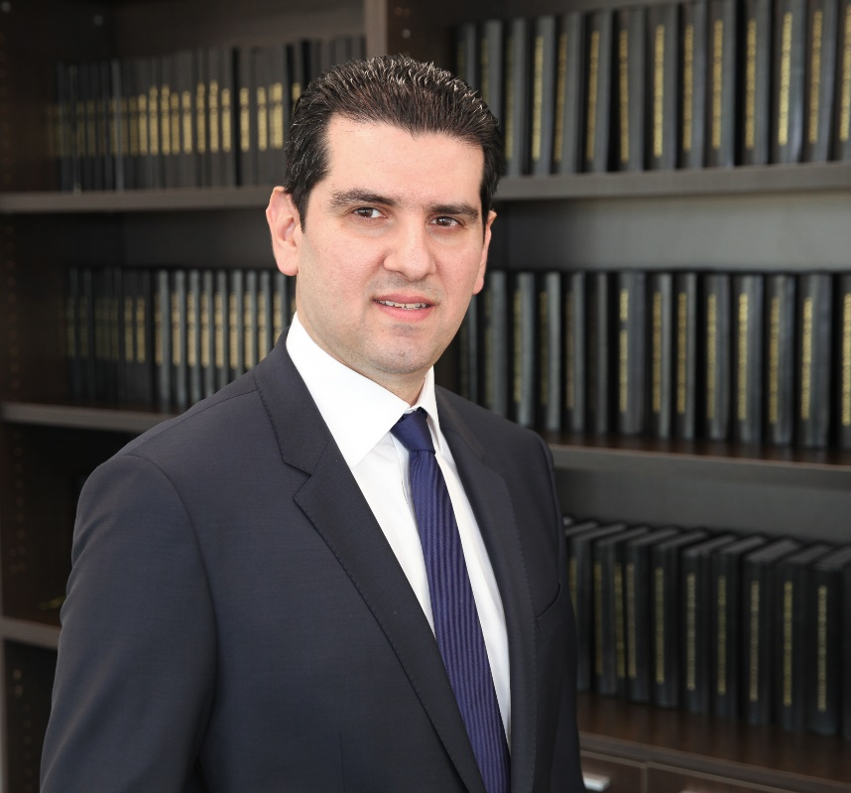
The firm’s founder
The firm’s founder is a Solicitor of the Supreme Court of England and Wales and a member of the Cyprus Bar Association. Before practicing in Cyprus he qualified as a solicitor at the London office of Simmons & Simmons and then moved to the London office of Hogan Lovells, where he was mainly involved in mergers and acquisitions (general), energy related mergers and acquisitions and energy related commercial and regulatory work.
Both the founder and the firm are consistently ranked in Chambers Global and The Legal 500.

Slide 4
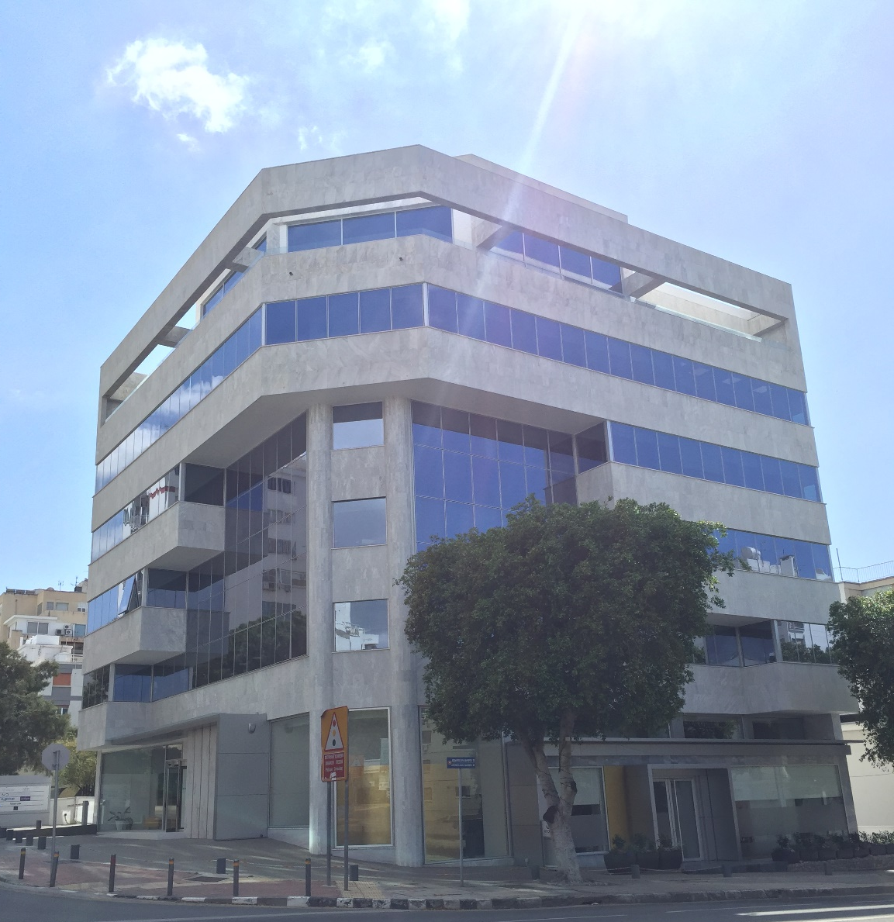
Our offices
Our offices are located in the heart of Nicosia in state of the art facilities.

Slide 6
Main areas of practice
Although a full service Cyprus law firm, the firm specializes in the following areas of law:
- International (and local) mergers and acquisitions;
- General corporate advice (including corporate disputes);
- Energy;
- General commercial work;
- Insolvency;
- Banking;
- Capital Markets;
- Intellectual Property;
- Employment Law;
- Real Estate; and
- Private Client.
We also specialize in:
- Corporate/Fiduciary services;
- Cyprus International Trusts;
- Cyprus Citizenship/Residence Permits; and
- Cyprus non-resident dom scheme.

Slide 7
Being a low-tax jurisdiction, Cyprus attracts a lot of overseas work. The firm specializes in assisting international law firms and clients with their work both in and through Cyprus and it also assists some local medium/big size groups of companies with their work in Cyprus.
Besides the provision of legal services, the firm offers fiduciary/corporate services, advises on Cyprus International Trusts, assists clients in obtaining Cypriot citizenship or Cypriot residence permits (see below), and in moving to Cyprus for tax reasons on our very tax-efficient non-resident dom scheme.

Slide 8
Corporate and Fiduciary Services
Setting up of Cyprus companies and offshore companies;
Looking after such entities including directorship;
Opening up of bank accounts; and
Representative offices.

Slide 9
Cyprus International Trusts
The firm can assist a client in the formation of a Cyprus International Trust. A trust can qualify as a Cyprus International Trust if the following pre-conditions are met:
the settlor is not a tax resident of the Republic of Cyprus during the year preceding the year of creating the trust;
at least one of the trustees is a permanent resident of the Republic of Cyprus;
no beneficiary, other than a charitable institution, is a tax resident of the Republic of Cyprus during the year preceding the year of creating the trust.
Cyprus International Trusts enjoy various tax advantages which make them very attractive for tax planning purposes.

Slide 10
Cyprus Residency and Citizenship
The firm has been one of the first to assist non-EU high-net-worth individuals in obtaining Cypriot citizenship or a Cypriot residence permit on economic grounds.
The firm assists clients with the relevant applications and with their investments in Cyprus in order to acquire the relevant citizenship or residence permit, which may include:
- Real estate, land development projects and infrastructure projects;
- Purchase or establishment or participation in Cyprus businesses and companies;
- Investment in Alternative Investment Funds or financial assets of Cyprus companies or Cyprus organisations that are licensed by the Cyprus Securities and Exchange Commission; and
- Combination of investments – investment in government bonds.

Slide 11
Taxation
Cyprus offers one of the most attractive tax systems in Europe. The country provides a simplified, effective and transparent tax regime that is fully compliant with the EU laws and regulations.
Cyprus has the lowest corporate tax rate in the Eurozone at 12,5%.
Dividend income, profits from overseas permanent establishments and profits from the sale of securities are exempt from tax .
There is no withholding tax on dividends, interest and royalties paid to non-residents of Cyprus (except royalties earned on rights used within Cyprus).
No capital gains tax is imposed on anything under Cyprus law except on gains from the disposal of real estate, provided that such real estate is situated in Cyprus.
Most international transactions are exempt from VAT.
Cyprus has also developed a wide network of double taxation treaties with 60 countries. Such treaties provide for nil or reduced withholding tax rates on dividends, interest, royalties and pensions received from abroad.
Cyprus offers a very attractive non-dom scheme whereby an individual who is a tax resident of Cyprus but he/she is not domiciled in Cyprus, will be exempt from tax on certain categories of income such as interest, rent, and dividends for seventeen years. Tax residency can be granted if an individual stays in Cyprus for more than 60 days, provided that she/he is not tax resident somewhere else in the world.

Slide 12
Contact information
Address: 2 Dramas St., 4th floor, Nicosia P.C. 1077, Cyprus
E-mail: info@damianoslaw.com
Telephone: (+357) 22021212
Fax: (+357) 22021213
Website: www.damianoslaw.com

Slide 13
Thank you

